Slide 1
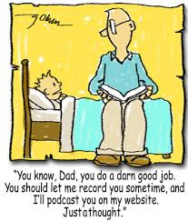
Reading at Milborne St Andrew School

Slide 2
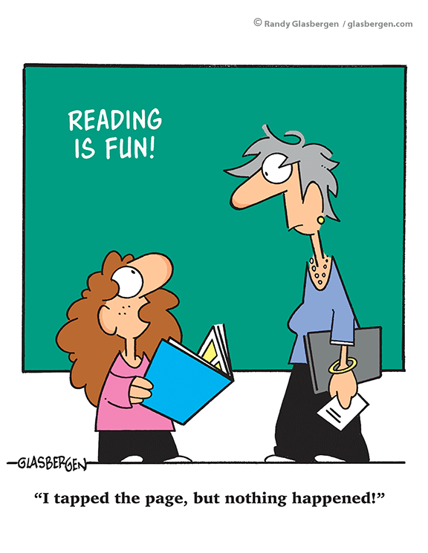
Opportunities to read include…
Phonics
Sight / Tricky Words
Shared Reading
Guided Reading
Independent Reading
One to One Reading

Slide 3
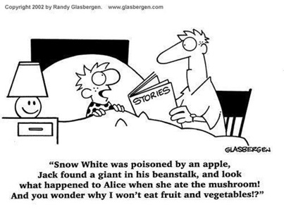
Reading Assessment Focus
Word
Apply phonic knowledge
Sound out words
Blend sounds together
Read tricky words
Read aloud
Read fluently

Slide 4
Reading Assessment Focus
Comprehension
Link what they have read to their own experiences
Discuss meanings of words
Discuss the characters and why they act in a certain way
Predict what will happen next
Listening to, discuss and express views about a wide range of poetry, stories and non-fiction at a level beyond that at which they can read independently
Learn poems by heart
Discuss the authors choice of vocabulary

Slide 5
READING WITH YOUR CHILD
Read to them every day.
Just before they go to bed is a good time … but not in front of the TV!
Be enthusiastic about the story … or choose another.
Allow the child to choose whenever possible. Yes, they will often choose their favourite over and over again … this is quite natural.

Slide 6
Before you read you may like to:
Read through the story yourself first. (It’s a big help if you know the story well … it helps you to lead up to the exciting bits and encourage joining in).
Decide (even practise) the bits to read like a giant or ant.
Decide good places to stop and ask; “What do you think will happen next?”
Decide which pictures to stop and talk about.

Slide 7
During the reading:
Show your enjoyment … laugh, smile, look scared, look sad, sound excited, etc.
Spend some time just reading the pictures and talking about them.
Use lots of describing language when you read the pictures and invite the child to help you.
Run your finger along the line under the words as you or the child read.
Talk about the pictures … “Can you see the wolf hiding?”

Slide 8
Difficulties or mistakes for the child…
If your child comes to a difficult word and stops, you may like to try some of the following ideas …
Ask them to look at the first letter of the word
Encourage sounding out each letter to build the word and blend the sounds together
Ask them to look at the picture for clues
Ask them to look for any words they might know
Ask them to think about the story
Ask them to look for patterns in words eg ing, -ed, ight

Slide 9
If they still do not know, then tell them the word. You can go back later to reread the tricky bit. Try to keep the story flowing so you can both enjoy reading together. It is more important for your child to know what the book is about, rather than read every word correctly.
Try to be positive and praise your child for their effort and achievement, even if they do not read the whole book fluently!

Slide 10
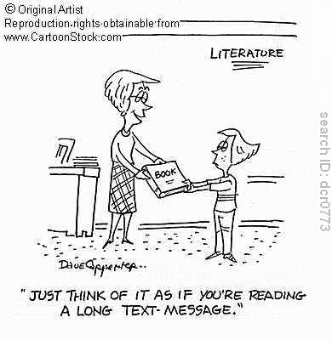
After reading:
Talk about similar experiences your child might have had. “Do you remember when you …” “It’s just like when you …”
Talk about the story afterwards. “Which bit did you like?” “Wasn’t it funny when …”

Slide 11
If you child enjoyed the story:
Read it again
Find another in the series
Find another by the same author
Find another on the same topic

Slide 12
Home Reading
Read with your child every day
Read a variety of texts and reading material
Read picture books
Use your local library
Encourage your child to follow their interests
Encourage your child to read writing in different formats and presentations

