Slide 1



CYP PUBLIC HEALTH SERVICE – SCHOOL NURSING

Slide 2

OUR ROLE
School Nursing works across Education and Health, providing a link between the school, home and the community. Our aims are;
To promote the health and wellbeing of all children and young people
To work with families and young people from five to nineteen years of age
To work with one school or a group of schools depending on an identified need
To work together with other Health Services, Education, Social Care and Voluntary Agencies to give children and young people the support they need

Slide 3

ACCESSING OUR SERVICE
School Nursing staff work with all school age children
We offer regular drop-in sessions in infant, junior and primary schools with no appointment needed.
Parents/Carers can ask your child's school for details of when the drop-in sessions are held, or check your School’s Newsletter.
We provide community based clinics for children, from the age of 7, experiencing problems with Enuresis (night time wetting).
We are also able to refer and signpost to other relevant services and Professionals.

Slide 4
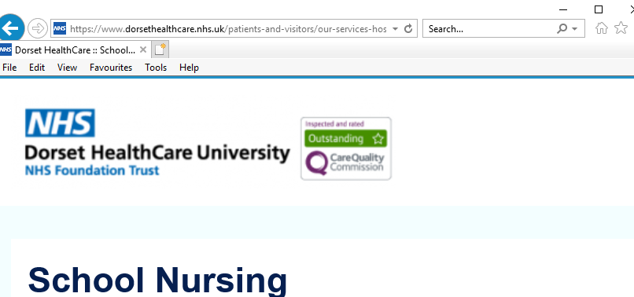
SCHOOL NURSING WEBPAGE
GOOGLE - SCHOOL NURSING DORSET FOR ALL THE CONTACT DETAILS AND RESOURCES YOU NEED

Slide 5
HEALTHY TED
Healthy Ted
“Healthy Ted” is used as a health education tool by the School Health Nursery Nurses to talk to the children about ’keeping healthy’ and the screening checks we offer to them.
During the Autumn term a School Health Nursery Nurse will visit each reception class to introduce themselves to the children, with the help of “Healthy Ted”.

Slide 6

NATIONAL CHILD MEASUREMENT PROGRAMME
Public Health England (PHE) needs to have a good understanding of how healthy children are, so that the best possible health services and advice can be provided for the children, their families and school communities, where needed.
As a result, a National Child Measurement Programme (NCMP) has been set up, to weigh and measure children, in England, in Reception and Year 6.
Along with PHE the School Health Nursery Nurses will give feedback on how your child is developing and advice on changes you can make to keep them healthy.

Slide 7

HEARING CHECK
As part of the Healthy Child Programme, all children will have a hearing check during their first year in school. This is to ensure that any hearing problems do not impact on your child’s learning and development.
You will be given a Health Check questionnaire– please complete and return it to your child’s school.
The hearing results will be returned to Parents/Carers in writing via the child the same day.
If a problem is identified, the School Health Nursery Nurse will share the results with the child’s teacher.
A referral to the Audiology Service may be needed, once consent has been given by the parent/carer.

Slide 8



DROP-INS
A Drop-in is an open access service that School Nursing aims to provide in every infant, junior and primary school. Drop-ins provide parents/carers and school staff with the opportunity to “drop-in” without an appointment, to discuss any aspect of a child’s health or well being with a School Health Nursery Nurse.
School Nursing can also support you with advice on the following issues;
Bed Wetting
Behaviour
Nutritional Advice
Sleep
Toileting
Emotional Wellbeing

Slide 9

CONTACT NUMBERS FOR THE SERVICE
Bournemouth - 01202 443035
Poole - 01202 691520
Christchurch - 01425 891157
West Dorset, Weymouth & Portland - 01305 752395
North Dorset, East Dorset & Purbeck - 01425 891153

