Slide 1
CYP PUBLIC HEALTH SERVICE – SCHOOL NURSING

Slide 2
OUR ROLE
School Nursing works across Education and Health, providing a link between the school, home and the community. Our aims are;
To promote the health and wellbeing of all children and young people
To work with families and young people from five to nineteen years of age
To work with one school or a group of schools depending on an identified need
To work together with other Health Services, Education, Social Care and Voluntary Agencies to give children and young people the support they need
PLEASE NOTE DURING THE COVID-19 PANDEMIC THERE MAY BE CHANGES IN THE WAY SCHOOL NURSING DELIVERS THEIR SERVICE

Slide 3
ACCESSING OUR SERVICE
School Nursing staff work with all school age children
We offer regular drop-in sessions in infant, junior and primary schools with no appointment needed.
Parents/Carers can ask their child's school for details of when the drop-in sessions are held, or check your School’s Newsletter.
We provide community based clinics for children, from the age of 7, experiencing problems with Enuresis (night time wetting).
We are able to refer and signpost to other relevant services and Professionals.
We use our Request for Support form to accept referrals for children and young people from other services, schools or parents

Slide 4
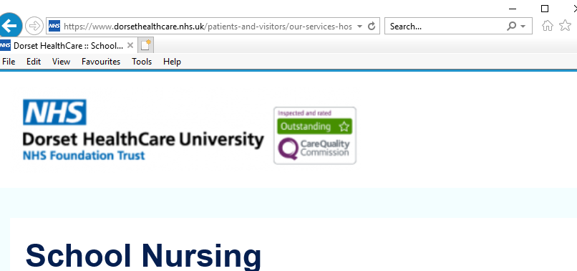
SCHOOL NURSING WEBPAGE
GOOGLE - SCHOOL NURSING DORSET FOR ALL THE CONTACT DETAILS AND RESOURCES YOU NEED

Slide 5
School Health Nursery Nurses
School Health Nursery Nurses go into the school during the Autumn term to introduce themselves and talk to all the reception classes about ’keeping healthy’ and the screening checks they will have - hearing checks and the NCMP growth measurements.

Slide 6
NATIONAL CHILD MEASUREMENT PROGRAMME
Public Health England (PHE) needs to have a good understanding of how healthy children are, so that the best possible health services and advice can be provided for the children, their families and school communities, where needed.
As a result, a National Child Measurement Programme (NCMP) has been set up, to weigh and measure children, in England, in Reception and Year 6.
Along with PHE the School Health Nursery Nurses will give feedback on how your child is developing and advice on changes you can make to keep them healthy.

Slide 7
SCHOOL ENTRY HEALTH REVIEW & HEARING CHECK
As part of the Healthy Child Programme, all children will have a hearing check during their first year in school. This is to ensure that any hearing problems do not impact on your child’s learning and development.
You will be sent an Ages and Stages Questionnaire (ASQ60) for the reception age group, you may remember filling these in with your Health Visitor in the past for your child – please complete and return as advised. If you identify any areas of concern the School Nursing Team will be in touch about support or referrals that may be required.
If a problem is identified, the hearing results will be shared with Parents/Carers, and with the child’s teacher.
A referral to the Audiology Service may be needed, once consent has been given by the parent/carer.

Slide 8
DROP-INS
A Drop-in is an open access service that School Nursing aims to provide in every infant, junior and primary school. Drop-ins provide parents/carers and school staff with the opportunity to “drop-in” without an appointment, to discuss any aspect of a child’s health or well being with a School Health Nursery Nurse.
School Nursing can also support you with advice on the following issues;
Bed Wetting
Behaviour
Nutritional Advice
Sleep
Toileting
Emotional Wellbeing

Slide 9
CONTACT NUMBER FOR THE SERVICE
Bournemouth, Christchurch, Poole and Dorset – 01929 557558

